Slide 1
Smart Contract-Based Access Control for the Internet of Things
Masanari Yamamoto
Yuta Nakamura

Slide 2
Background
Thanks to the rapid advance of networking technologies, a huge number of objects are being connected to the Internet (e.g. IoT)
Strict access control has to be implemented into loT systems
Smart lock system for home doors
Automatic operation vehicle control devices
Notes:
Such as smart speaker, Automatic vehicle operation device

Slide 3
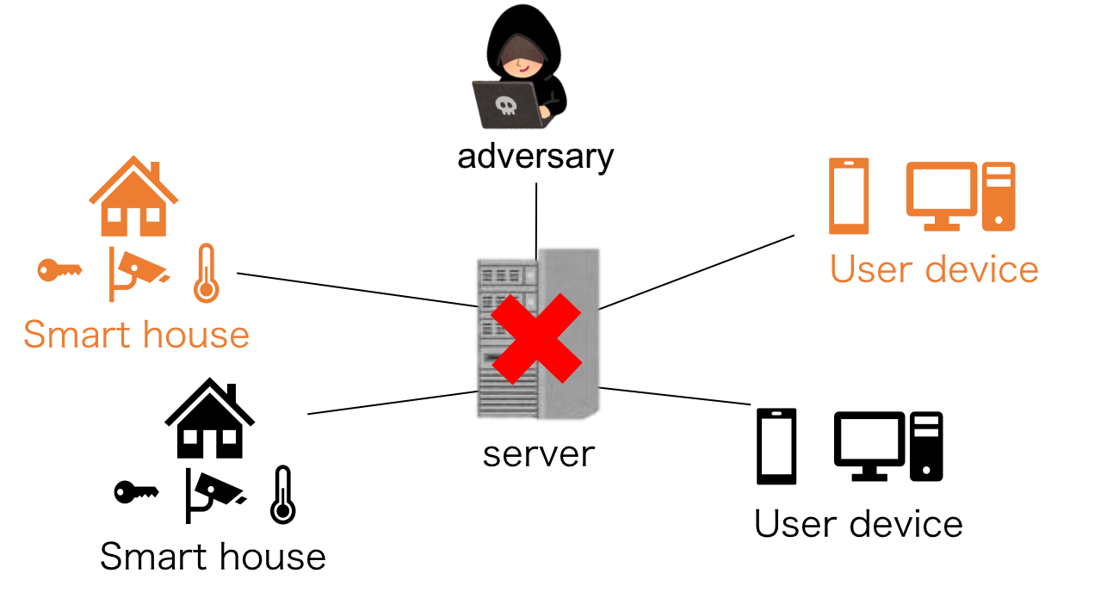
Background
However, traditional centralized access control schemes have crucial issues
When adversaries hack centralized access control schemes, they can tamper with access control policies
If the centralized server breaks down, the system is not available (e.g. Someone can’t enter his/her house)
Notes:
For example an adversary can access another person’s house network and control web camera

Slide 4
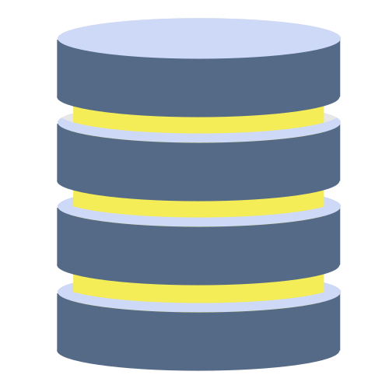
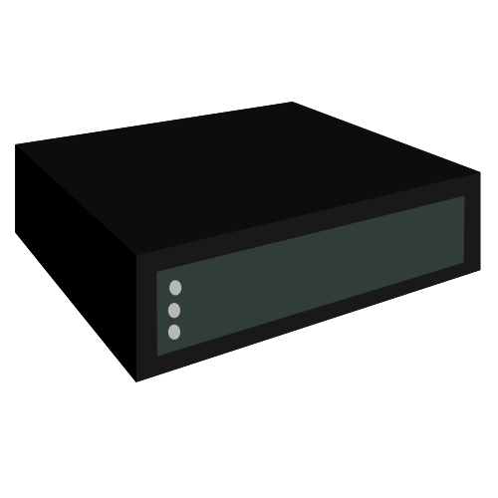


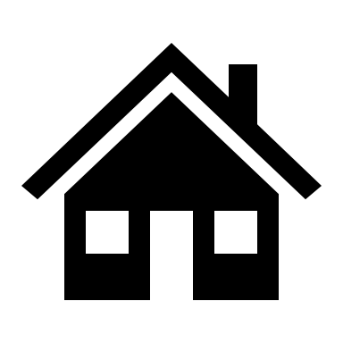
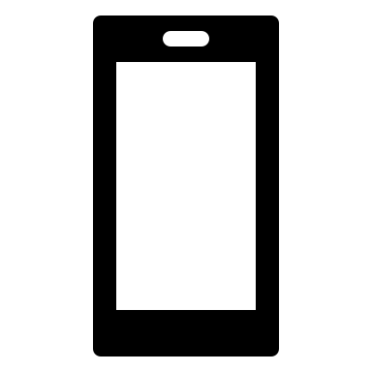

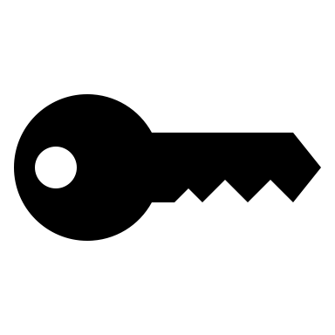

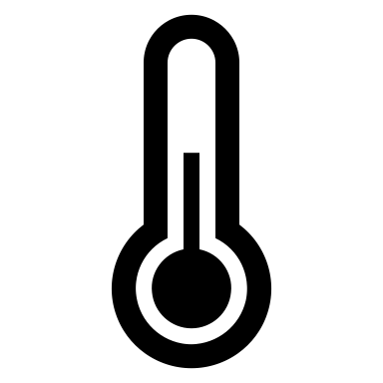
Objective
We propose a distributed access control scheme based on ^{[Y. Zhang,et.al, 2018]}
storage
server
block chain
adversary
P2P network
user device
smart house
Notes:
We use the blockchain which is a distributed ledger to achieve a distributed access control.
Each node has same blockchain.

Slide 5
Originality
Why blockchain?
Trustworthy: prevent malicious users from tampering with access control policies
Distributed: access requests are controlled by all nodes instead of the admin
blockchain
request
storage
server
adversary
deny
P2Pnetwork
request
accept
User device
blockchain
blockchain
Smart house

Slide 6
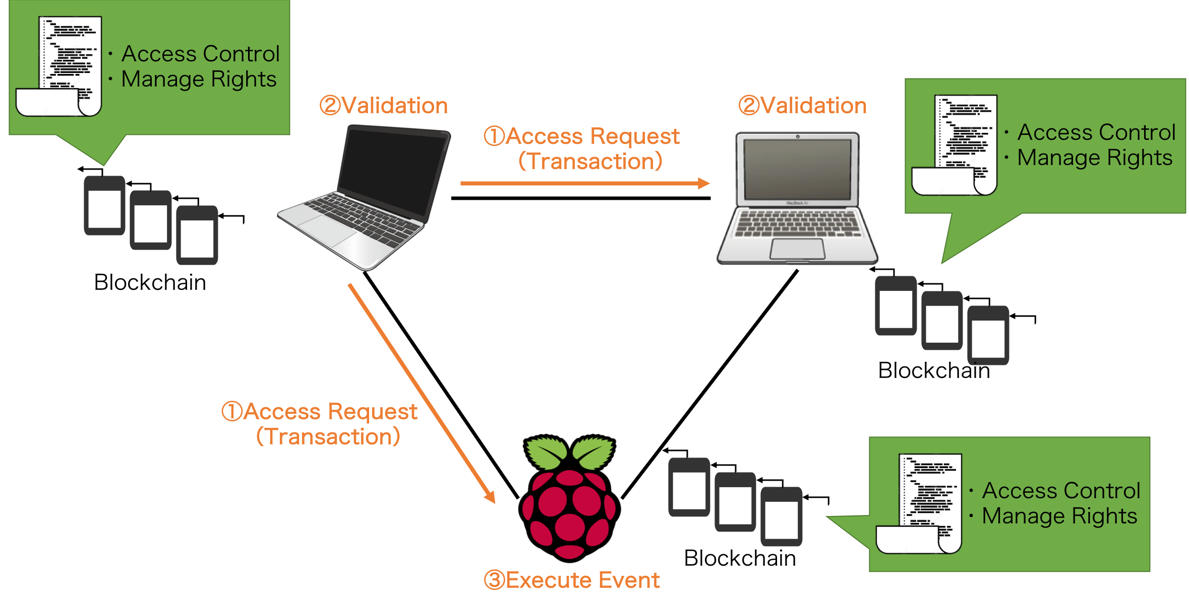
Architecture
IoT device
Notes:
This is the architecture we implemented.
Each node has smart contract on their local blockchain.
The smart contract is a program to manage access control and access right.
We assume that this laptop send an access request to this IoT device.
First this laptop broadcast an access request to all neighbors.
Second, each neighbor validate the access request by executing smart contract on their blockchain.
If the result of validation is true, right laptop store the access request in newest block and transmit this block to the IoT device
Finally, IoT device validate access request same as each node and execute event if validation result is true..

Slide 7
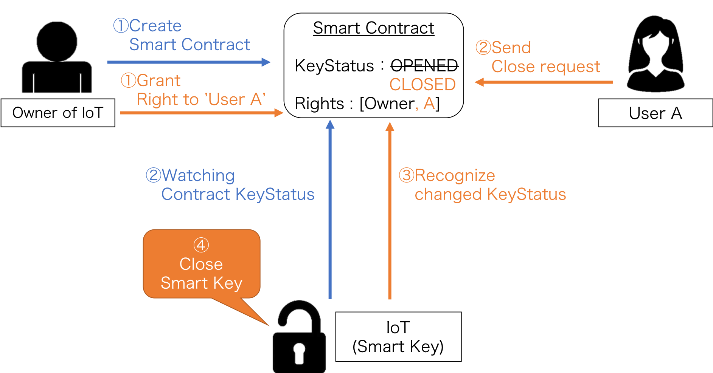
Smart key
Notes:
We applied this architecture to smart lock
We assume that user A want to access this Smart Key.
A device owner creates an access control program called smart contract and deploy it to the network.
The device is watching the status of the contract keystatus
When the device recognize a change of status, it open and close the key

Slide 8
Summary and Challenges
We achieved a distributed access control scheme by applying it to smart key.
This scheme is able to be applied to car sharing, guest house and so on.
In our system block propagation delay will happen.
Our challenge is to speed up the access authentication time.

